Slide 1
事件驱动与Swing

Slide 2
Swing组件的分类
  （1）顶层容器：JFrame,JApplet,JDialog,JWindow共4个。
  （2）中间容器：JPanel,JScrollPane,JSplitPane,JToolBar等。
  （3）特殊容器：在GUI上起特殊作用的中间层，如JInternalJFrame,JLayeredPane,JRootPane等。
  （4）基本控件：实现人机交互的组件，如Jbutton, JComboBox, JList, JMenu, JSlider, JTextField等。
  （5）不可编辑信息的显示：向用户显示不可编辑信息的组件，例如JLabel, JProgressBar, ToolTip等。
  （6）可编辑信息的显示：向用户显示能被编辑的格式化信息的组件，如JColorChooser, JFileChoose, JFileChooser, JTable, JTextArea等。

Slide 3
Swing程序设计流程
  （1）引入swing包
  （2）选择"外观和感觉"
  （3）设置顶层容器
  （4）设置按钮和标签
  （5）向容器中添加组件
  （6）在组件周围添加边界
  （7）进行事件处理

Slide 4
事件监听机制流程图
外部动作
2 有监听器所监听的动作作于事件源上
4 将事件对象传给事件处理方式
事件对象
事件源(组件)
3 产生事件对象
监听器
监听引发事件的动作
(事件处理方式)
1 将监听器注册到事件源

Slide 5
事件类的层次关系
ActionEvent
ContainerEvent
AdjustmentEvent
FocusEvent
MouseEvent
EventObject
AWTEvent
ComponentEvent
InputEvent
ItemEvent
PaintEvent
KeyEvent
TextEvent
WindowEvent
ListSelectionEvent

Slide 6
用户行为、源对象和事件类型
用户行为 | 源对象 | 触发的事件类型
点击按钮 | JButton | ActionEvent
再文本域按下回车 | JTextField | ActionEvent
选定一个新项 | JComboBox | ItemEvent,ActionEvent
选定（多）项 | JList | ListSelectionEvent
点击复选框 | JCheckBox | ItemEvent,ActionEvent
点击单选按钮 | JRadioButton | ItemEvent,ActionEvent
选定菜单项 | JMenuItem | ActionEvent
移动滚动条 | JScrollBar | AdjustmentEvent
窗口打开、关闭、图标化（最小化）或关闭 | Window | WindowEvent
从容器中添加或删除组件 | Container | ContainerEvent
组建移动、改变大小、隐藏或显示 | Component | ComponentEvent
组件获得或失去焦点 | Component | FocusEvent
释放或按下键盘上的键 | Component | KeyEvent
按下、释放、点击、移入或移出鼠标 | Component | MouseEvent
移动或拖动鼠标 | Component | MouseEvent

Slide 7
事件、事件监听器和监听器方法
事件类 | 监听器接口 | 监听器方法
ActionEvent | ActionListener | actionPerformed(ActionEvent)
ItemEvent | ItemListener | itemStateChanged(ItemEvent)
MouseEvent | MouseListener | MousePressed(MouseEvent); MouseReleased(MouseEvent); MouseEntered(MouseEvent);MouseExited(MouseEvent); MouseClicked(MouseEvent);
 | MouseMotionListener | MouseDragged(MouseEvent); MouseMoved(MouseEvent);
KeyEvent | KeyListener | KeyPressed(KeyEvent); KeyReleased(KeyEvent); KeyTyped(KeyEvent);
WindowEvent | WindowListener | WindowClosing(WindowEvent); WindowOpened(WindowEvent); WindowIconified(WindowEvent); WindowDeiconified(WindowEvent); WindowClosed(WindowEvent); WindowActivated(WindowEvent); WindowDeactiviated(WindowEvent);
ContainerEvent | ContainerListener | ComponentAdded(ContainerEvent); ComponentRemoved(ContainerEvent);
ComponentEvent | ComponentListener | ComponentMoved(ContainerEvent); ComponentHidden(ContainerEvent); ComponentResized(ContainerEvent); ComponentShown(ContainerEvent);
FocusEvent | FocusListener | focusGained(FocusEvent);focusLost(FocusEvent)
AdjustmentEvent | AdjustmentListener | adjustmentValueChanged(AdjustmentEvent)

Slide 8
事件的监听、注册和处理
监听器对象的类必须是相应的事件监听器接口的实例，以确保监听器有处理该事件的正确方法
监听器对象必须由源对象注册

Slide 9
方便适配器
适配器 | 接口
WindowAdapter | WindowListener
MouseAdapter | MouseListener
MouseMotionAdapter | MouseMotionListener
KeyAdapter | KeyListener
ContainerAdapter | ContainerListener
ComponentAdapter | ComponentListener
FocusAdapter | FocusListener

Slide 10
键盘事件之键常量
常量 | 描述
VK_HOME | Home键
VK_END | End键
VK_PGUP | Page Up键
VK_PGDN | Page Down键
VK_UP | 上箭头
VK_DOWN | 下箭头
VK_LEFT | 左箭头
VK_RIGHT | 右箭头
VK_ESCAPE | Esc键
VK_TAB | Tab键
常量 | 描述
VK_CONTROL | Ctrl键
VK_SHIFT | Shift键
VK_BACK_SPACE | 退格键
VK_CAPS_LOCK | 大写字母锁定键
VK_NUM_LOCK | 数字键盘锁定键
VK_ENTER | 回车键
VK_UNDEFINED
VK_F1到VK_F12 | 功能键F1到F2
VK_0到VK_9 | 数字键0到9
VK_A到VK_Z | 字母键A到Z

Slide 11
匿名内部类
匿名内部类实一种特殊的内部类，可以当作内部类来看
  匿名内部类必须是扩展父类或实现接口的，但它不能有明确的extends或implements语句
  匿名内部类必须实现父类或接口中所有的抽象方法
  匿名内部类总是使用父类的无参构造方法来创建实例
  匿名内部类编译为名为OuterClassName$n.class的类

Slide 12

Events and Listeners
The Java standard class library contains several classes that represent typical events
Certain objects, such as an applet or a graphical button, generate (fire) an event when it occurs
Other objects, called listeners, respond to events
We can write listener objects to do whatever we want when an event occurs
Event
Generator
Listener
This object may
generate an event
This object waits for and
responds to an event
When an event occurs, the generator calls the appropriate method of the listener, passing an object that describes the event.

Slide 13
Listener Interfaces
We can create a listener object by writing a class that implements a particular listener interface.
The Java standard class library contains several interfaces that correspond to particular event categories.
The MouseListener interface contains methods that correspond to mouse events
After creating the listener, we add the listener to the component that might generate the event to set up a formal relationship between the generator and listener.
The following are called key events:
  key pressed: a keyboard key is pressed down
  key released: a keyboard key is released
  key typed: a keyboard key is pressed and released
The KeyListener interface handles key events
Listener classes are often implemented as inner classes, nested within the component that they are listening to.

Slide 14
Mouse Events
The following are mouse events:
  mouse pressed: the mouse button is pressed down
  mouse released: the mouse button is released
  mouse clicked: the mouse button is pressed and released
  mouse entered: the mouse pointer is moved over a particular component
  mouse exited: the mouse pointer is moved off of a particular component
The following are called mouse motion events:
  mouse moved: the mouse is moved
  mouse dragged: the mouse is moved while the mouse button is held down
There is a corresponding MouseMotionListener interface
One class can serve as both a generator and a listener
One class can serve as a listener for multiple event types

Slide 15
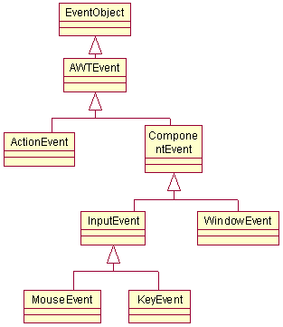
Events Classes Hierarchy
Event classes represent events and contain methods for getting information on the events.
Here is the class hierarchy
for events classes:

Slide 16
Events Source Classes
An event source is the component that generates an event.
A source must register listeners who may wish to take some action when the event is generated.
When an event occurs the source informs all registered listeners for this event.
An event listener can register or un-register with the following methods:
  1. public void addTypeListener(TypeListener t)
button.addActionListener(new ActionListener());
  2. public void removeTypeListener (TypeListener t)
  button.removeActionListener(new ActionListener());
Type is the name of the event and t is a reference to the event listener.

Slide 17
Events Listener Classes
The java.awt.event package contains interfaces and classes for dealing with events.
Each listener interface is a specification for receiving a particular type of event.
An event listener class implements the listener interfaces of interest to the class.
Every event handler should satisfy these two conditions:
  1. Implement an interface.
  2. Register as event listener.

Slide 18
Types of Listeners
ActionListener
KeyListener, MouseListener, MouseMotionListener, TextListener
AdjustmentListener, ComponentListener, ContainerListener, FocusListener, WindowListener
Listeners are Interfaces.

Slide 19








Events: A Pictorial View

Slide 20
Java Graphical User Interface Components
Outline
Introduction
Swing Overview
JLabel
Event Handling Model
JTextField and JPasswordField
How Event Handling Works
JTextArea
JButton
JCheckBox
JComboBox
Mouse Event Handling
Layout Managers
FlowLayout
BorderLayout
GridLayout
Panels
Creating a Self-Contained Subclass of JPanel
Windows
Using Menus with Frames

Slide 21
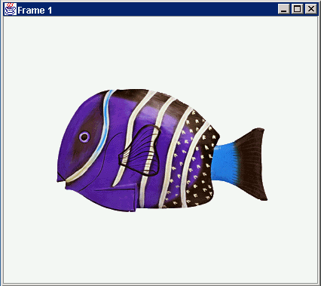
JFrame
Internal structure
JPanel
JFrame
JButton
containers
JPanel
JLabel
GUI
JButton
JLabel

Slide 22
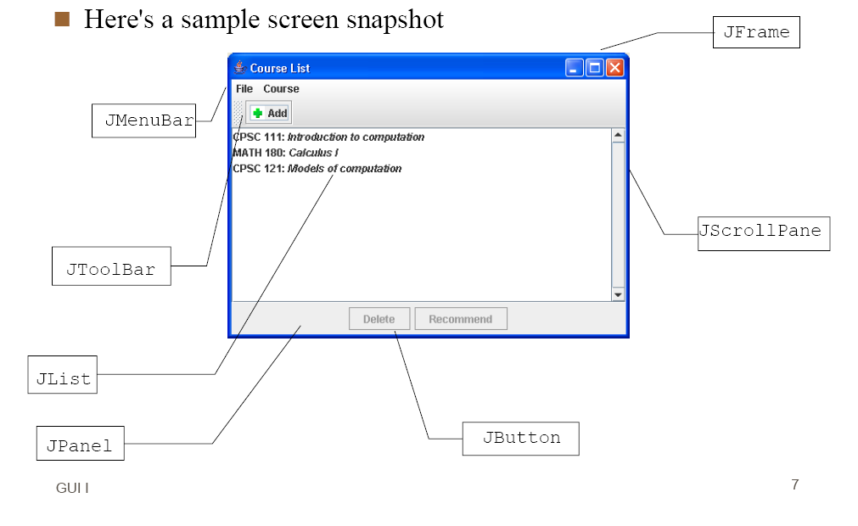

Slide 23
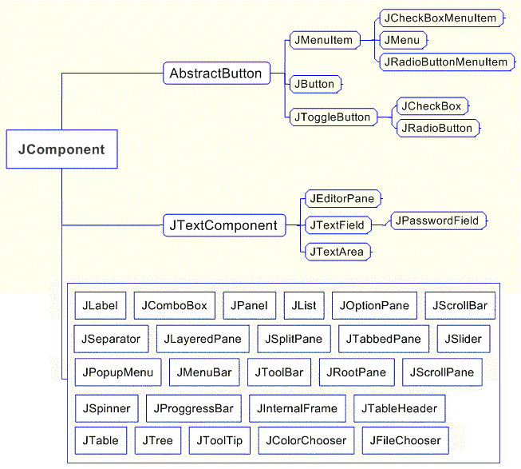

Slide 24
First Swing
Import Swing package
  import javax.swing.*;
  java.awt.* and java.awt.event.*
At least one top-level container
  JFrame, JDialog, JApplet
  JFrame frame = new JFrame(“HelloWorld”);
  setVisible(true); pack();
Create Swing components and add to content pane of frame
  JLabel label = new JLabel(“Hello World”);
  frame.getContentPane().add(label);

Slide 25
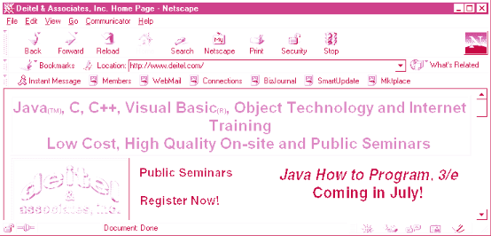
1 Introduction
Button
Label
Menu
Menu bar
Text field

Slide 26
2 Swing Overview
Swing GUI components
  Defined in package javax.swing
  Original GUI components from Abstract Windowing Toolkit in java.awt
    Heavyweight components - rely on local platform's windowing system for look and feel
  Swing components are lightweight
    Written in Java, not weighed down by complex GUI capabilities of platform
    More portable than heavyweight components
  Swing components allow programmer to specify look and feel
    Can change depending on platform
    Can be the same across all platforms

Slide 27
2 Swing Overview
Swing component inheritance hierarchy
    Component defines methods that can be used in its subclasses (for example, paint and repaint)
    Container - collection of related components
      When using JFrames, attach components to the content pane (a Container)
      Method add to add components to content pane
    JComponent - superclass to most Swing components
    Much of a component's functionality inherited from these classes
java.lang.Object
java.awt.Component
java.awt.Container
javax.swing.JComponent

Slide 28
3 JLabel
Labels
  Provide text instructions on a GUI
  Read-only text
  Programs rarely change a label's contents
  Class JLabel (subclass of JComponent)
Methods
  Can declare label text in constructor
  myLabel.setToolTipText( "Text" )
    Displays "Text"in a tool tip when mouse over label
  myLabel.setText( "Text" )
  myLabel.getText()

Slide 29
3 JLabel
Icon
  Object that implements interface Icon
  One class is ImageIcon (.gif and .jpeg images)
  Display an icon with setIcon method (of class JLabel)
    myLabel.setIcon( myIcon );
    myLabel.getIcon //returns current Icon
Alignment
  Set of integer constants defined in interface SwingConstants (javax.swing)
    SwingConstants.LEFT
    Use with JLabel methods setHorizontalTextPosition and setVerticalTextPosition

Slide 30
1 // : LabelTest.java
2 // Demonstrating the JLabel class.
3 import javax.swing.*;
4 import java.awt.*;
1. import
1.1 extend JFrame
1.2 Declarations
1.3 Create container to hold labels
1.4 Initialize JLabels
5 import java.awt.event.*;
6
7 public class LabelTest extends JFrame {
8 private JLabel label1, label2, label3;
9
10 public LabelTest()
11 {
12 super( "Testing JLabel" );
13
14 Container c = getContentPane(); //可以不要
15 c.setLayout( new FlowLayout() );//可把c. 去掉
16
This creates a new ImageIcon (more in later chapters) to use with the label.
17 // JLabel constructor with a string argument
18 label1 = new JLabel( "Label with text" );
19 label1.setToolTipText( "This is label1" );
20 c.add( label1 );
21
22 // JLabel constructor with string, Icon and
23 // alignment arguments
24 Icon bug = new ImageIcon( "bug1.gif" );
25 label2 = new JLabel( "Label with text and icon",
26 bug, SwingConstants.LEFT );
27 label2.setToolTipText( "This is label2" );
28 c.add( label2 );
29
30 // JLabel constructor no arguments

Slide 31
31 label3 = new JLabel();
32 label3.setText( "Label with icon and text at bottom" );
33 label3.setIcon( bug );
34 label3.setHorizontalTextPosition(
1.4 Initialize JLabels
35 SwingConstants.CENTER );
36 label3.setVerticalTextPosition(
37 SwingConstants.BOTTOM );
38 label3.setToolTipText( "This is label3" );
39 c.add( label3 );
40
41 setSize( 275, 170 );
42 show(); // 改成setVisible(true);
43 }
44
45 public static void main( String args[] )
46 {
47 LabelTest app = new LabelTest();
48
49 app.addWindowListener(
50 new WindowAdapter() {
51 public void windowClosing( WindowEvent e )
52 {
53 System.exit( 0 );
54 }
55 }
56 );
57 }
58 }
<Anchor0>

Slide 32
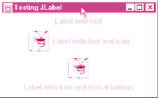
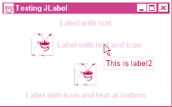
Program Output

Slide 33
4 Event Handling Model
GUIs are event driven
  Generate events when user interacts with GUI
    Mouse movements, mouse clicks, typing in a text field, etc.
  Event information stored in object that extends AWTEvent
To process an event
  Register an event listener
    Object from a class that implements an event-listener interface (from java.awt.event or javax.swing.event)
    "Listens" for events
  Implement event handler
    Method that is called in response to an event
    Each event handling interface has one or more event handling methods that must be defined

Slide 34
4 Event Handling Model
Delegation event model
  Use of event listeners in event handling
  Processing of event delegated to particular object
When an event occurs
  GUI component notifies its listeners
    Calls listener's event handling method
Example:
  Enter pressed in a JTextField
  Method actionPerformed called for registered listener
  Details in following section

Slide 35
5 JTextField and JPasswordField
JTextFields and JPasswordFields
  Single line areas in which text can be entered or displayed
  JPasswordFields show inputted text as *
  JTextField extends JTextComponent
    JPasswordField extends JTextField
When Enter pressed
  ActionEvent occurs
  Currently active field "has the focus"
Methods
  Constructor
    JTextField( 10 ) - sets textfield with 10 columns of text
    JTextField( "Hi" ) - sets text, width determined automatically

Slide 36
5 JTextField and JPasswordField
Methods (continued)
  setEditable( boolean )
    If true, user can edit text
  getPassword
    Class JPasswordField
    Returns password as an array of type char
Example
  Create JTextFields and a JPasswordField
  Create and register an event handler
    Displays a dialog box when Enter pressed

Slide 37
1 // Fig. 29.7: TextFieldTest.java
2 // Demonstrating the JTextField class.
3 import java.awt.*;
4 import java.awt.event.*;
1. import
1.1 Declarations
1.2 Constructor
1.3 GUI components
1.4 Initialize text fields
5 import javax.swing.*;
6
7 public class TextFieldTest extends JFrame {
8 private JTextField text1, text2, text3;
9 private JPasswordField password;
10
11 public TextFieldTest()
12 {
13 super( "Testing JTextField and JPasswordField" );
14
15 Container c = getContentPane();
16 c.setLayout( new FlowLayout() );
17
18 // construct textfield with default sizing
19 text1 = new JTextField( 10 );
20 c.add( text1 );
21
22 // construct textfield with default text
23 text2 = new JTextField( "Enter text here" );
24 c.add( text2 );
25
26 // construct textfield with default text and
27 // 20 visible elements and no event handler
28 text3 = new JTextField( "Uneditable text field", 20 );
29 text3.setEditable( false );
30 c.add( text3 );

Slide 38
31
32 // construct textfield with default text
33 password = new JPasswordField( "Hidden text" );
34 c.add( password );
2. main
35
36 TextFieldHandler handler = new TextFieldHandler();
37 text1.addActionListener( handler );
38 text2.addActionListener( handler );
39 text3.addActionListener( handler );
40 password.addActionListener( handler );
41
42 setSize( 325, 100 );
43 show();
44 }
45
46 public static void main( String args[] )
47 {
48 TextFieldTest app = new TextFieldTest();
49
50 app.addWindowListener(
51 new WindowAdapter() {
52 public void windowClosing( WindowEvent e )
53 {
54 System.exit( 0 );
55 }
56 }
57 );
58 }
59
60 // inner class for event handling

Slide 39
61 private class TextFieldHandler implements ActionListener {
62 public void actionPerformed( ActionEvent e )
63 {
64 String s = "";
3. TextFieldHandler implements ActionListener
3.1 Display dialog box
65
66 if ( e.getSource() == text1 )
e.getSource() returns a Component reference, which is cast to a JPasswordField
67 s = "text1: " + e.getActionCommand();
68 else if ( e.getSource() == text2 )
69 s = "text2: " + e.getActionCommand();
70 else if ( e.getSource() == text3 )
71 s = "text3: " + e.getActionCommand();
72 else if ( e.getSource() == password ) {
73 JPasswordField pwd =
74 (JPasswordField) e.getSource();
75 s = "password: " +
76 new String( pwd.getPassword() );
77 }
78
79 JOptionPane.showMessageDialog( null, s );
80 }
81 }
82 }

Slide 40









Program Output

Slide 41
5.1 How Event Handling Works
Registering event listeners
  All JComponents contain an object of class EventListenerList called listenerList
  When text1.addActionListener( handler ) executes
    New entry placed into listenerList
Handling events
  When event occurs, has an event ID
    Component uses this to decide which method to call
    If ActionEvent, then actionPerformed called (in all registered ActionListeners)

Slide 42
6 JTextArea
Area for manipulating multiple lines of text
  Like JTextField, inherits from JTextComponent
  Many of the same methods
JScrollPane
  Provides scrolling
  Initialize with component
    new JScrollPane( myComponent )
  Can set scrolling policies (always, as needed, never)
    See book for details

Slide 43
6 JTextArea
Box container
  Uses BoxLayout layout manager
  Arrange GUI components horizontally or vertically
  Box b = Box.createHorizontalbox();
    Arranges components attached to it from left to right, in order attached

Slide 44
1 // Fig. 29.9: TextAreaDemo.java
2 // Copying selected text from one text area to another.
3 import java.awt.*;
4 import java.awt.event.*;
1. import
1.1 Declarations
1.2 Create Box container
1.3 Add JScrollPane
1.4 Create button and use inner class for event handling
5 import javax.swing.*;
6
7 public class TextAreaDemo extends JFrame {
8 private JTextArea t1, t2;
9 private JButton copy;
10
11 public TextAreaDemo()
12 {
13 super( "TextArea Demo" );
14
15 Box b = Box.createHorizontalBox();
16
17 String s = "This is a demo string to\n" +
Initialize JScrollPane to t1 and attach to Box b
18 "illustrate copying text\n" +
19 "from one TextArea to \n" +
20 "another TextArea using an\n"+
21 "external event\n";
22
23 t1 = new JTextArea( s, 10, 15 );
24 b.add( new JScrollPane( t1 ) );
25
26 copy = new JButton( "Copy >>>" );
27 copy.addActionListener(
28 new ActionListener() {
29 public void actionPerformed( ActionEvent e )
30 {

Slide 45
31 t2.setText( t1.getSelectedText() );
32 }
33 }
34 );
2. main
35 b.add( copy );
36
37 t2 = new JTextArea( 10, 15 );
38 t2.setEditable( false );
39 b.add( new JScrollPane( t2 ) );
40
41 Container c = getContentPane();
42 c.add( b );
43 setSize( 425, 200 );
44 show();
45 }
46
47 public static void main( String args[] )
48 {
49 TextAreaDemo app = new TextAreaDemo();
50
51 app.addWindowListener(
52 new WindowAdapter() {
53 public void windowClosing( WindowEvent e )
54 {
55 System.exit( 0 );
56 }
57 }
58 );
59 }
60 }

Slide 46
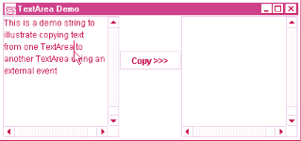
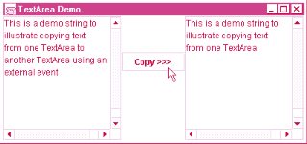
Program Output

Slide 47
7 JButton
Button
  Component user clicks to trigger an action
  Several types of buttons
    Command buttons, toggle buttons, check boxes, radio buttons
Command button
  Generates ActionEvent when clicked
  Created with class JButton
    Inherits from class AbstractButton
Jbutton
  Text on face called button label
  Each button should have a different label
  Support display of Icons

Slide 48
7 JButton
Constructors
  Jbutton myButton = new JButton( "Button" );
  Jbutton myButton = new JButton( "Button", myIcon );
Method
  setRolloverIcon( myIcon )
    Sets image to display when mouse over button

Slide 49
1 // Fig. 29.11: ButtonTest.java
2 // Creating JButtons.
3 import java.awt.*;
4 import java.awt.event.*;
6
1. import
1.1 Declarations
1.2 Initialize buttons and Icons
1.3 Register event handler
5 import javax.swing.*;
7 public class ButtonTest extends JFrame {
8 private JButton plainButton, fancyButton;
9
10 public ButtonTest()
11 {
12 super( "Testing Buttons" );
13
14 Container c = getContentPane();
15 c.setLayout( new FlowLayout() );
16
17 // create buttons
18 plainButton = new JButton( "Plain Button" );
19 c.add( plainButton );
20
21 Icon bug1 = new ImageIcon( "bug1.gif" );
22 Icon bug2 = new ImageIcon( "bug2.gif" );
23 fancyButton = new JButton( "Fancy Button", bug1 );
24 fancyButton.setRolloverIcon( bug2 );
25 c.add( fancyButton );
26
27 // create an instance of inner class ButtonHandler
28 // to use for button event handling
29 ButtonHandler handler = new ButtonHandler();
30 fancyButton.addActionListener( handler );

Slide 50
31 plainButton.addActionListener( handler );
32
33 setSize( 275, 100 );
34 show();
2. main
3. Event handler
35 }
36
37 public static void main( String args[] )
38 {
39 ButtonTest app = new ButtonTest();
40
41 app.addWindowListener(
42 new WindowAdapter() {
43 public void windowClosing( WindowEvent e )
44 {
45 System.exit( 0 );
46 }
47 }
48 );
49 }
50
51 // inner class for button event handling
52 private class ButtonHandler implements ActionListener {
53 public void actionPerformed( ActionEvent e )
54 {
55 JOptionPane.showMessageDialog( null,
56 "You pressed: " + e.getActionCommand() );
57 }
58 }
59 }

Slide 51





Program Output

Slide 52
8 JCheckBox
State buttons
  JToggleButton
    Subclasses JCheckBox, JRadioButton
  Have on/off (true/false) values
  We discuss JCheckBox in this section
Initialization
  JCheckBox myBox = new JCheckBox( "Title" );
When JCheckBox changes
  ItemEvent generated
    Handled by an ItemListener, which must define itemStateChanged
  Register with addItemListener

Slide 53
8 JCheckBox (II)
ItemEvent methods
  getStateChange
    Returns ItemEvent.SELECTED or ItemEvent.DESELECTED

Slide 54
1 // Fig. 29.12: CheckBoxTest.java
2 // Creating Checkbox buttons.
3 import java.awt.*;
4 import java.awt.event.*;
1. import
1.1 Declarations
1.2 Initialization
1.3 Register event handler
5 import javax.swing.*;
6
7 public class CheckBoxTest extends JFrame {
8 private JTextField t;
9 private JCheckBox bold, italic;
10
11 public CheckBoxTest()
12 {
13 super( "JCheckBox Test" );
14
15 Container c = getContentPane();
16 c.setLayout(new FlowLayout());
17
18 t = new JTextField( "Watch the font style change", 20 );
19 t.setFont( new Font( "TimesRoman", Font.PLAIN, 14 ) );
20 c.add( t );
21
22 // create checkbox objects
23 bold = new JCheckBox( "Bold" );
24 c.add( bold );
25
26 italic = new JCheckBox( "Italic" );
27 c.add( italic );
28
29 CheckBoxHandler handler = new CheckBoxHandler();
30 bold.addItemListener( handler );

Slide 55
31 italic.addItemListener( handler );
32
33 addWindowListener(
34 new WindowAdapter() {
2. main
3. Event handler CheckBoxHandler
35 public void windowClosing( WindowEvent e )
36 {
37 System.exit( 0 );
38 }
39 }
40 );
41
42 setSize( 275, 100 );
43 show();
44 }
Because CheckBoxHandler implements ItemListener, it must define method itemStateChanged
45
46 public static void main( String args[] )
47 {
48 new CheckBoxTest();
49 }
50
51 private class CheckBoxHandler implements ItemListener {
52 private int valBold = Font.PLAIN;
53 private int valItalic = Font.PLAIN;
54
55 public void itemStateChanged( ItemEvent e )
56 {
57 if ( e.getSource() == bold )
58 if ( e.getStateChange() == ItemEvent.SELECTED )
59 valBold = Font.BOLD;
60 else

Slide 56




61 valBold = Font.PLAIN;
62
63 if ( e.getSource() == italic )
64 if ( e.getStateChange() == ItemEvent.SELECTED )
3. Event handler CheckBoxHandler
Program Output
65 valItalic = Font.ITALIC;
66 else
67 valItalic = Font.PLAIN;
68
69 t.setFont(
70 new Font( "TimesRoman", valBold + valItalic, 14 ) );
71 t.repaint();
72 }
73 }
74 }

Slide 57
9 JComboBox
Combo box (drop down list)
  List of items, user makes a selection
  Class JComboBox
    Generate ItemEvents
JComboBox
  Numeric index keeps track of elements
    First element added at index 0
    First item added is appears as currently selected item when combo box appears

Slide 58
9 JComboBox (II)
Methods
  getSelectedIndex
    Returns the index of the currently selected item
  setMaximumRowCount( n )
    Set the maximum number of elements to display when user clicks combo box
    Scrollbar automatically provided

Slide 59
1 // Fig. 29.13: ComboBoxTest.java
2 // Using a JComboBox to select an image to display.
3 import java.awt.*;
4 import java.awt.event.*;
1. import
1.1 Initialization
1.2 Constructor
1.3 Initialize JComboBox
1.4 Register ItemListener
5 import javax.swing.*;
6
7 public class ComboBoxTest extends JFrame {
8 private JComboBox images;
9 private JLabel label;
10 private String names[] =
11 { "bug1.gif", "bug2.gif",
12 "travelbug.gif", "buganim.gif" };
13 private Icon icons[] =
14 { new ImageIcon( names[ 0 ] ),
15 new ImageIcon( names[ 1 ] ),
16 new ImageIcon( names[ 2 ] ),
17 new ImageIcon( names[ 3 ] ) };
18
19 public ComboBoxTest()
20 {
21 super( "Testing JComboBox" );
22
23 Container c = getContentPane();
24 c.setLayout( new FlowLayout() );
25
26 images = new JComboBox( names );
27 images.setMaximumRowCount( 3 );
28
29 images.addItemListener(
30 new ItemListener() {

Slide 60
31 public void itemStateChanged( ItemEvent e )
32 {
33 label.setIcon(
34 icons[ images.getSelectedIndex() ] );
1.5 Event handler
2. main
35 }
36 }
37 );
38
39 c.add( images );
40
41 label = new JLabel( icons[ 0 ] );
42 c.add( label );
43
44 setSize( 350, 100 );
45 show();
46 }
47
48 public static void main( String args[] )
49 {
50 ComboBoxTest app = new ComboBoxTest();
51
52 app.addWindowListener(
53 new WindowAdapter() {
54 public void windowClosing( WindowEvent e )
55 {
56 System.exit( 0 );
57 }
58 }
59 );
60 }
61 }

Slide 61
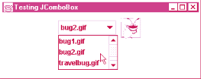
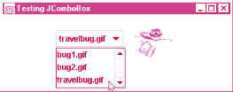
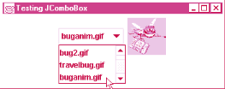
Program Output

Slide 62
10 Mouse Event Handling
Mouse events
  Can be trapped for any GUI component derived from java.awt.Component
  Mouse event handling methods
    Take a MouseEvent object
      Contains info about event, including x and y coordinates
      Methods getX and getY
  MouseListener and MouseMotionListener methods called automatically (if component is registered)
    addMouseListener
    addMouseMotionListener

Slide 63
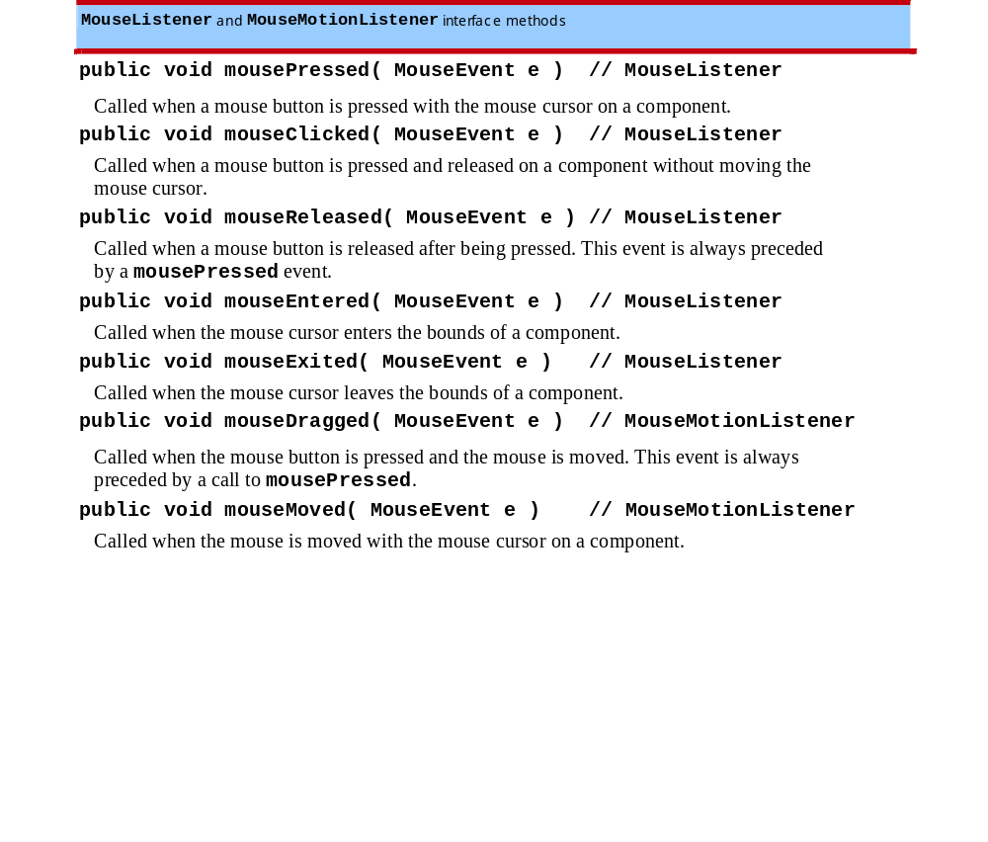
10 Mouse Event Handling (II)
Interface methods for MouseListener and MouseMotionListener

Slide 64
1 // Fig. 29.15: MouseTracker.java
2 // Demonstrating mouse events.
3
4 import java.awt.*;
1. import
1.1 Implements MouseListener, MouseMotionListener
1.2 Register event handlers (this)
1.3 Define event handler methods
5 import java.awt.event.*;
6 import javax.swing.*;
7
8 public class MouseTracker extends JFrame
9 implements MouseListener, MouseMotionListener {
10 private JLabel statusBar;
11
12 public MouseTracker()
13 {
14 super( "Demonstrating Mouse Events" );
15
16 statusBar = new JLabel();
17 getContentPane().add( statusBar, BorderLayout.SOUTH );
18
19 // application listens to its own mouse events
20 addMouseListener( this );
21 addMouseMotionListener( this );
22
23 setSize( 275, 100 );
24 show();
25 }
26
27 // MouseListener event handlers
28 public void mouseClicked( MouseEvent e )
29 {
30 statusBar.setText( "Clicked at [" + e.getX() +

Slide 65
30 statusBar.setText( "Clicked at [" + e.getX() +
31 ", " + e.getY() + "]" );
32 }
33
1.3 Define event handler methods
34 public void mousePressed( MouseEvent e )
35 {
36 statusBar.setText( "Pressed at [" + e.getX() +
37 ", " + e.getY() + "]" );
38 }
39
40 public void mouseReleased( MouseEvent e )
41 {
42 statusBar.setText( "Released at [" + e.getX() +
43 ", " + e.getY() + "]" );
44 }
45
46 public void mouseEntered( MouseEvent e )
47 {
48 statusBar.setText( "Mouse in window" );
49 }
50
51 public void mouseExited( MouseEvent e )
52 {
53 statusBar.setText( "Mouse outside window" );
54 }
55
56 // MouseMotionListener event handlers
57 public void mouseDragged( MouseEvent e )
58 {
59 statusBar.setText( "Dragged at [" + e.getX() +
60 ", " + e.getY() + "]" );

Slide 66
61 }
62
63 public void mouseMoved( MouseEvent e )
64 {
65 statusBar.setText( "Moved at [" + e.getX() +
1.3 Define event handler methods
2. main
66 ", " + e.getY() + "]" );
67 }
68
69 public static void main( String args[] )
70 {
71 MouseTracker app = new MouseTracker();
72
73 app.addWindowListener(
74 new WindowAdapter() {
75 public void windowClosing( WindowEvent e )
76 {
77 System.exit( 0 );
78 }
79 }
80 );
81 }
82 }

Slide 67







Program Output

Slide 69
Demo
布局管理器
  第7版13章
  每个布局管理器有些属性可以动态改变
  setLayout, validate doLayout

Slide 70
11 Layout Managers
Layout managers
  Arrange GUI components on a container
  Provide basic layout capabilities
    Easier to use than determining exact size and position of every component
    Programmer concentrates on "look and feel" rather than details

Slide 71
11.1 FlowLayout
Most basic layout manager
  Components placed left to right in order added
  When edge of container reached, continues on next line
  Components can be left-aligned, centered (default), or right-aligned
Method
  setAlignment
    FlowLayout.LEFT, FlowLayout.CENTER, FlowLayout.RIGHT
  layoutContainer( Container )
    Update Container specified with layout

Slide 72
1 // Fig. 29.17: FlowLayoutDemo.java
2 // Demonstrating FlowLayout alignments.
3 import java.awt.*;
4 import java.awt.event.*;
1. import
1.1 Declarations
1.2 Initialize layout
1.3 Create buttons and event handlers
5 import javax.swing.*;
6
7 public class FlowLayoutDemo extends JFrame {
8 private JButton left, center, right;
9 private Container c;
10 private FlowLayout layout;
11
12 public FlowLayoutDemo()
13 {
14 super( "FlowLayout Demo" );
15
16 layout = new FlowLayout();
17
18 c = getContentPane();
19 c.setLayout( layout );
20
21 left = new JButton( "Left" );
22 left.addActionListener(
23 new ActionListener() {
24 public void actionPerformed( ActionEvent e )
25 {
26 layout.setAlignment( FlowLayout.LEFT );
27
28 // re-align attached components
29 layout.layoutContainer( c );
30 }

Slide 73
31 }
32 );
33 c.add( left );
34
1.3 Create buttons and event handlers
35 center = new JButton( "Center" );
36 center.addActionListener(
37 new ActionListener() {
38 public void actionPerformed( ActionEvent e )
39 {
40 layout.setAlignment( FlowLayout.CENTER );
41
42 // re-align attached components
43 layout.layoutContainer( c );
44 }
45 }
46 );
47 c.add( center );
48
49 right = new JButton( "Right" );
50 right.addActionListener(
51 new ActionListener() {
52 public void actionPerformed( ActionEvent e )
53 {
54 layout.setAlignment( FlowLayout.RIGHT );
55
56 // re-align attached components
57 layout.layoutContainer( c );
58 }
59 }
60 );

Slide 74



61 c.add( right );
62
63 setSize( 300, 75 );
64 show();
65 }
2. main
Program Output
66
67 public static void main( String args[] )
68 {
69 FlowLayoutDemo app = new FlowLayoutDemo();
70
71 app.addWindowListener(
72 new WindowAdapter() {
73 public void windowClosing( WindowEvent e )
74 {
75 System.exit( 0 );
76 }
77 }
78 );
79 }
80 }

Slide 75
11.2 BorderLayout
BorderLayout
  Default manager for content pane
  Arrange components into 5 regions
    North, south, east, west, center
  Up to 5 components can be added directly
    One for each region
  Components placed in
    North/South - Region is as tall as component
    East/West - Region is as wide as component
    Center - Region expands to take all remaining space

Slide 76
11.2 BorderLayout
Methods
  Constructor: BorderLayout( hGap, vGap );
    hGap - horizontal gap space between regions
    vGap - vertical gap space between regions
    Default is 0 for both
  Adding components
    myLayout.add( component, position )
    component - component to add
    position - BorderLayout.NORTH
      SOUTH, EAST, WEST, CENTER similar
  setVisible( boolean ) ( in class Jbutton)
    If false, hides component
  layoutContainer( container ) - updates container, as before

Slide 77
1 // Fig. 29.18: BorderLayoutDemo.java
2 // Demonstrating BorderLayout.
3 import java.awt.*;
4 import java.awt.event.*;
1. import
1.1 Declarations
1.2 Initialize layout
1.3 Register event handler
5 import javax.swing.*;
6
7 public class BorderLayoutDemo extends JFrame
8 implements ActionListener {
9 private JButton b[];
10 private String names[] =
11 { "Hide North", "Hide South", "Hide East",
12 "Hide West", "Hide Center" };
13 private BorderLayout layout;
14
15 public BorderLayoutDemo()
16 {
17 super( "BorderLayout Demo" );
18
19 layout = new BorderLayout( 5, 5 );
20
21 Container c = getContentPane();
22 c.setLayout( layout );
23
24 // instantiate button objects
25 b = new JButton[ names.length ];
26
27 for ( int i = 0; i < names.length; i++ ) {
28 b[ i ] = new JButton( names[ i ] );
29 b[ i ].addActionListener( this );
30 }

Slide 78
31
32 // order not important
33 c.add( b[ 0 ], BorderLayout.NORTH ); // North position
34 c.add( b[ 1 ], BorderLayout.SOUTH ); // South position
1.4 Add components to container
1.5 Event handler
2. main
35 c.add( b[ 2 ], BorderLayout.EAST ); // East position
36 c.add( b[ 3 ], BorderLayout.WEST ); // West position
37 c.add( b[ 4 ], BorderLayout.CENTER ); // Center position
38
39 setSize( 300, 200 );
40 show();
41 }
42
43 public void actionPerformed( ActionEvent e )
44 {
45 for ( int i = 0; i < b.length; i++ )
46 if ( e.getSource() == b[ i ] )
47 b[ i ].setVisible( false );
48 else
49 b[ i ].setVisible( true );
50
51 // re-layout the content pane
52 layout.layoutContainer( getContentPane() );
53 }
54
55 public static void main( String args[] )
56 {
57 BorderLayoutDemo app = new BorderLayoutDemo();
58
59 app.addWindowListener(
60 new WindowAdapter() {

Slide 79
61 public void windowClosing( WindowEvent e )
62 {
63 System.exit( 0 );
64 }
65 }
66 );
67 }
68 }

Slide 80
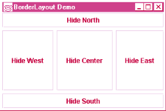
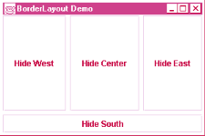
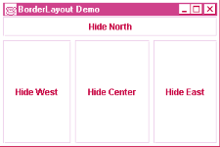
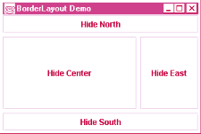
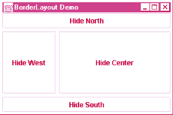
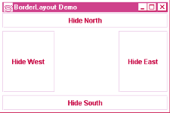
Program Output

Slide 81
11.3 GridLayout
GridLayout
  Divides container into a grid
  Components placed in rows and columns
  All components have same width and height
    Added starting from top left, then from left to right
    When row full, continues on next row, left to right
Constructors
  GridLayout( rows, columns, hGap, vGap )
    Specify number of rows and columns, and horizontal and vertical gaps between elements (in pixels)
  GridLayout( rows, columns )
    Default 0 for hGap and vGap

Slide 82
11.3 GridLayout
Updating containers
  Container method validate
    Re-layouts a container for which the layout has changed
  Example:
    Container c = getContentPane;
    c.setLayout( myLayout );
    if ( x = 3 ){
    c.setLayout( myLayout2 );
    c.validate();
    }
    Changes layout and updates c if condition met

Slide 83
1 // Fig. 29.19: GridLayoutDemo.java
2 // Demonstrating GridLayout.
3 import java.awt.*;
4 import java.awt.event.*;
5 import javax.swing.*;
1. import
1.1 Declarations
1.2 Initialize layout
1.3 Register event handler
6
7 public class GridLayoutDemo extends JFrame
8 implements ActionListener {
9 private JButton b[];
10 private String names[] =
11 { "one", "two", "three", "four", "five", "six" };
12 private boolean toggle = true;
13 private Container c;
14 private GridLayout grid1, grid2;
15
16 public GridLayoutDemo()
17 {
18 super( "GridLayout Demo" );
19
20 grid1 = new GridLayout( 2, 3, 5, 5 );
21 grid2 = new GridLayout( 3, 2 );
22
23 c = getContentPane();
24 c.setLayout( grid1 );
25
26 // create and add buttons
27 b = new JButton[ names.length ];
28
29 for (int i = 0; i < names.length; i++ ) {
30 b[ i ] = new JButton( names[ i ] );
31 b[ i ].addActionListener( this );

Slide 84
32 c.add( b[ i ] );
33 }
34
35 setSize( 300, 150 );
36 show();
1.4 Add components to container
1.5 Define event handler
1.6 Update layout (c.validate())
2. main
37 }
38
39 public void actionPerformed( ActionEvent e )
40 {
41 if ( toggle )
42 c.setLayout( grid2 );
43 else
44 c.setLayout( grid1 );
45
46 toggle = !toggle;
47 c.validate();
48 }
49
50 public static void main( String args[] )
51 {
52 GridLayoutDemo app = new GridLayoutDemo();
53
54 app.addWindowListener(
55 new WindowAdapter() {
56 public void windowClosing( WindowEvent e )
57 {
58 System.exit( 0 );
59 }
60 }
61 );
62 }
63 }

Slide 85
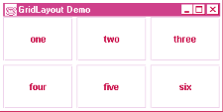
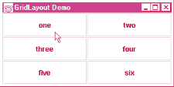
Program Output

Slide 86
12 Panels
Complex GUIs
  Each component needs to be placed in an exact location
  Can use multiple panels
    Each panel's components arranged in a specific layout
Panels
  Class JPanel inherits from JComponent, which inherits from java.awt.Container
    Every JPanel is a Container
  JPanels can have components (and other JPanels) added to them
    JPanel sized to components it contains
    Grows to accommodate components as they are added

Slide 87
12 Panels
Usage
  Create panels, and set the layout for each
  Add components to the panels as needed
  Add the panels to the content pane (default BorderLayout)

Slide 88
1 // Fig. 20: PanelDemo.java
2 // Using a JPanel to help lay out components.
3 import java.awt.*;
4 import java.awt.event.*;
1. import
1.1 Declarations
1.2 Initialize buttonPanel
1.3 Panel uses GridLayout
1.4 Add components to panel
1.5 Add panel to content pane (BorderLayout. SOUTH)
5 import javax.swing.*;
6
7 public class PanelDemo extends JFrame {
8 private JPanel buttonPanel;
9 private JButton buttons[];
10
11 public PanelDemo()
12 {
13 super( "Panel Demo" );
14
15 Container c = getContentPane();
16 buttonPanel = new JPanel();
17 buttons = new JButton[ 5 ];
18
19 buttonPanel.setLayout(
20 new GridLayout( 1, buttons.length ) );
21
22 for ( int i = 0; i < buttons.length; i++ ) {
23 buttons[ i ] = new JButton( "Button " + (i + 1) );
24 buttonPanel.add( buttons[ i ] );
25 }
26
27 c.add( buttonPanel, BorderLayout.SOUTH );
28
29 setSize( 425, 150 );
30 show();

Slide 89
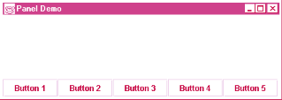
31 }
32
33 public static void main( String args[] )
34 {
2. main
Program Output
35 PanelDemo app = new PanelDemo();
36
37 app.addWindowListener(
38 new WindowAdapter() {
39 public void windowClosing( WindowEvent e )
40 {
41 System.exit( 0 );
42 }
43 }
44 );
45 }
46 }

Slide 90
13 Creating a Self-Contained Subclass of JPanel
JPanel
  Can be used as a dedicated drawing area
    Receive mouse events
    Can extend to create new components
  Combining Swing GUI components and drawing can lead to improper display
    GUI may cover drawing, or may be able to draw over GUI components
  Solution: separate the GUI and graphics
    Create dedicated drawing areas as subclasses of JPanel

Slide 91
13 Creating a Self-Contained Subclass of JPanel (II)
Swing components inheriting from JComponent
  Contain method paintComponent
    Helps to draw properly in a Swing GUI
  When customizing a JPanel, override paintComponent public void paintComponent( Graphics g )
  {
  super.paintComponent( g );
  //additional drawing code
  }
  Call to superclass paintComponent ensures painting occurs in proper order
    The call should be the first statement - otherwise, it will erase any drawings before it

Slide 92
13 Creating a Self-Contained Subclass of JPanel (III)
JFrame and JApplet
  Not subclasses of JComponent
    Do not contain paintComponent
  Override paint to draw directly on subclasses
Events
  JPanels do not create events like buttons
  Can recognize lower-level events
    Mouse and key events

Slide 93
13 Creating a Self-Contained Subclass of JPanel (IV)
Example
  Create a subclass of JPanel named SelfContainedPanel that listens for its own mouse events
    Draws an oval on itself (overrides paintComponent)
  Import SelfContainedPanel into another class
    The other class contains its own mouse handlers
  Add an instance of SelfContainedPanel to the content pane

Slide 94
1 // Fig. 29.21: SelfContainedPanelTest.java
2 // Creating a self-contained subclass of JPanel
3 // that processes its own mouse events.
4 import java.awt.*;
1. import SelfContainedPanel
1.1 Create object
1.2 Add to content pane
1.3 Mouse event handler for application window
5 import java.awt.event.*;
6 import javax.swing.*;
7 import com.deitel.chtp3.ch29.SelfContainedPanel;
8
9 public class SelfContainedPanelTest extends JFrame {
10 private SelfContainedPanel myPanel;
11
12 public SelfContainedPanelTest()
13 {
14 myPanel = new SelfContainedPanel();
15 myPanel.setBackground( Color.yellow );
16
17 Container c = getContentPane();
18 c.setLayout( new FlowLayout() );
19 c.add( myPanel );
20
21 addMouseMotionListener(
22 new MouseMotionListener() {
23 public void mouseDragged( FMouseEvent e )
24 {
25 setTitle( "Dragging: x=" + e.getX() +
26 "; y=" + e.getY() );
27 }
28
29 public void mouseMoved( MouseEvent e )
30 {

Slide 95
31 setTitle( "Moving: x=" + e.getX() +
32 "; y=" + e.getY() );
33 }
34 }
1.3 Mouse event handler for application window
2. main
35 );
36
37 setSize( 300, 200 );
38 show();
39 }
40
41 public static void main( String args[] )
42 {
43 SelfContainedPanelTest app =
44 new SelfContainedPanelTest();
45
46 app.addWindowListener(
47 new WindowAdapter() {
48 public void windowClosing( WindowEvent e )
49 {
50 System.exit( 0 );
51 }
52 }
53 );
54 }
55 }

Slide 96
56 // Fig. 21: SelfContainedPanel.java
57 // A self-contained JPanel class that
58 // handles its own mouse events.
59 package com.deitel.chtp3.ch29;
Class SelfContainedPanel
1. extends JPanel
1.1 Mouse event handler
60
61 import java.awt.*;
62 import java.awt.event.*;
63 import javax.swing.*;
64
65 public class SelfContainedPanel extends JPanel {
66 private int x1, y1, x2, y2;
67
68 public SelfContainedPanel()
69 {
70 addMouseListener(
71 new MouseAdapter() {
72 public void mousePressed( MouseEvent e )
73 {
74 x1 = e.getX();
75 y1 = e.getY();
76 }
77
78 public void mouseReleased( MouseEvent e )
79 {
80 x2 = e.getX();
81 y2 = e.getY();
82 repaint();
83 }
84 }
85 );

Slide 97
86
87 addMouseMotionListener(
88 new MouseMotionAdapter() {
89 public void mouseDragged( MouseEvent e )
1.1 Mouse event handler
2. Override paintComponent
90 {
91 x2 = e.getX();
92 y2 = e.getY();
93 repaint();
94 }
95 }
96 );
97 }
98
99 public Dimension getPreferredSize()
100 {
101 return new Dimension( 150, 100 );
102 }
103
104 public void paintComponent( Graphics g )
105 {
106 super.paintComponent( g );
107
108 g.drawOval( Math.min( x1, x2 ), Math.min( y1, y2 ),
109 Math.abs( x1 - x2 ), Math.abs( y1 - y2 ) );
110 }
111 }

Slide 98
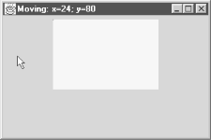
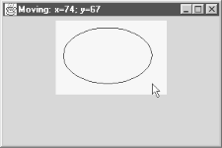
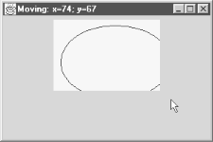
Program Output

Slide 99
14 Windows
JFrame
  Inherits from java.awt.Frame, which inherits from java.awt.Window
  JFrame is a window with a title bar and a border
    Not a lightweight component - not written completely in Java
    Window part of local platform's GUI components
      Different for Windows, Macintosh, and UNIX
JFrame operations when user closes window
  Controlled with method setDefaultCloseOperation
    Interface WindowConstants (javax.swing) has three constants to use
    DISPOSE_ON_CLOSE, DO_NOTHING_ON_CLOSE, HIDE_ON_CLOSE (default)

Slide 100
14 Windows (II)
Windows take up valuable resources
  Explicitly remove windows when not needed with method dispose (of class Window, indirect superclass of JFrame)
    Or, use setDefaultCloseOperation
  DO_NOTHING_ON_CLOSE - you determine what happens when user wants to close window
Display
  By default, window not displayed until method show called
  Can display by calling method setVisible( true )
  Method setSize - make sure to set a window's size, otherwise only the title bar will appear

Slide 101
14 Windows (III)
All windows generate window events
  addWindowListener
  WindowListener interface has 7 methods
    windowActivated
    windowClosed (called after window closed)
    windowClosing (called when user initiates closing)
    windowDeactivated
    windowIconified (minimized)
    windowDeiconified
    windowOpened

Slide 102
15 Using Menus with Frames
Menus
  Important part of GUIs
  Perform actions without cluttering GUI
  Attached to objects of classes that have method setJMenuBar
    JFrame and JApplet
Classes used to define menus
  JMenuBar - container for menus, manages menu bar
  JMenuItem - manages menu items
    Menu items - GUI components inside a menu
    Can initiate an action or be a submenu

Slide 103
15 Using Menus with Frames (II)
Classes used to define menus (continued)
  JMenu - manages menus
    Menus contain menu items, and are added to menu bars
    Can be added to other menus as submenus
    When clicked, expands to show list of menu items
  JCheckBoxMenuItem
    Manages menu items that can be toggled
    When selected, check appears to left of item
  JRadioButtonMenuItem
    Manages menu items that can be toggled
    When multiple JRadioButtonMenuItems are part of a group, only one can be selected at a time
    When selected, filled circle appears to left of item

Slide 104
15 Using Menus with Frames (III)
Mnemonics
  Provide quick access to menu items (File)
    Can be used with classes that have subclass javax.swing.AbstractButton
  Use method setMnemonic
  JMenu fileMenu = new JMenu( "File" )
  fileMenu.setMnemonic( 'F' );
    Press Alt + F to access menu
Methods
  setSelected( true )
    Of class AbstractButton
    Sets button/item to selected state

Slide 105
15 Using Menus with Frames (IV)
Methods (continued)
  addSeparator()
    Class JMenu
    Inserts separator line into menu
Dialog boxes
  Modal - No other window can be accessed while it is open (default)
    Modeless - other windows can be accessed
  JOptionPane.showMessageDialog( parentWindow, String, title, messageType )
  parentWindow - determines where dialog box appears
    null - displayed at center of screen
    window specified - dialog box centered horizontally over parent

Slide 106
15 Using Menus with Frames (V)
Using menus
  Create menu bar
    Set menu bar for JFrame ( setJMenuBar( myBar ); )
  Create menus
    Set Mnemonics
  Create menu items
    Set Mnemonics
    Set event handlers
  If using JRadioButtonMenuItems
    Create a group: myGroup = new ButtonGroup();
    Add JRadioButtonMenuItems to the group

Slide 107
15 Using Menus with Frames (VI)
Using menus (continued)
  Add menu items to appropriate menus
    myMenu.add( myItem );
    Insert separators if necessary: myMenu.addSeparator();
  If creating submenus, add submenu to menu
    myMenu.add( mySubMenu );
  Add menus to menu bar
    myMenuBar.add( myMenu );
Example
  Use menus to alter text in a JLabel
  Change color, font, style
  Have a "File" menu with a "About" and "Exit" items

Slide 108
1 // Fig. 22: MenuTest.java
2 // Demonstrating menus
3 import javax.swing.*;
4 import java.awt.event.*;
1. import
1.1 extends JFrame
1.2 Declare objects
1.3 Create menubar
1.4 Set menubar for JFrame
2. Create File menu
2.1 Create menu item
2.2 Event handler
5 import java.awt.*;
6
7 public class MenuTest extends JFrame {
8 private Color colorValues[] =
9 { Color.black, Color.blue, Color.red, Color.green };
10 private JRadioButtonMenuItem colorItems[], fonts[];
11 private JCheckBoxMenuItem styleItems[];
12 private JLabel display;
13 private ButtonGroup fontGroup, colorGroup;
14 private int style;
15
16 public MenuTest()
17 {
18 super( "Using JMenus" );
19
20 JMenuBar bar = new JMenuBar(); // create menubar
21 setJMenuBar( bar ); // set the menubar for the JFrame
22
23 // create File menu and Exit menu item
24 JMenu fileMenu = new JMenu( "File" );
25 fileMenu.setMnemonic( 'F' );
26 JMenuItem aboutItem = new JMenuItem( "About..." );
27 aboutItem.setMnemonic( 'A' );
28 aboutItem.addActionListener(
29 new ActionListener() {
30 public void actionPerformed( ActionEvent e )

Slide 109
31 {
32 JOptionPane.showMessageDialog( MenuTest.this,
33 "This is an example\nof using menus",
34 "About", JOptionPane.PLAIN_MESSAGE );
2.2 Event handler
2.3 Add menu item
2.4 Create menu item
2.5 Event handler
2.6 Add menu item
2.7 Add menu to menubar
3. Create Format menu
35 }
36 }
37 );
38 fileMenu.add( aboutItem );
39
40 JMenuItem exitItem = new JMenuItem( "Exit" );
41 exitItem.setMnemonic( 'x' );
42 exitItem.addActionListener(
43 new ActionListener() {
44 public void actionPerformed( ActionEvent e )
45 {
46 System.exit( 0 );
47 }
48 }
49 );
50 fileMenu.add( exitItem );
51 bar.add( fileMenu ); // add File menu
52
53 // create the Format menu, its submenus and menu items
54 JMenu formatMenu = new JMenu( "Format" );
55 formatMenu.setMnemonic( 'r' );
56
57 // create Color submenu
58 String colors[] =
59 { "Black", "Blue", "Red", "Green" };
60 JMenu colorMenu = new JMenu( "Color" );

Slide 110
61 colorMenu.setMnemonic( 'C' );
62 colorItems = new JRadioButtonMenuItem[ colors.length ];
63 colorGroup = new ButtonGroup();
64 ItemHandler itemHandler = new ItemHandler();
3.1 Create menu items
3.2 Add menu items to Color submenu
3.3 Register event handler
3.4 Add Color submenu to Format menu
4. Create Font submenu
4.1 Create and add menu items
65
66 for ( int i = 0; i < colors.length; i++ ) {
67 colorItems[ i ] =
68 new JRadioButtonMenuItem( colors[ i ] );
69 colorMenu.add( colorItems[ i ] );
70 colorGroup.add( colorItems[ i ] );
71 colorItems[ i ].addActionListener( itemHandler );
72 }
73
74 colorItems[ 0 ].setSelected( true );
75 formatMenu.add( colorMenu );
76 formatMenu.addSeparator();
77
78 // create Font submenu
79 String fontNames[] =
80 { "TimesRoman", "Courier", "Helvetica" };
81 JMenu fontMenu = new JMenu( "Font" );
82 fontMenu.setMnemonic( 'n' );
83 fonts = new JRadioButtonMenuItem[ fontNames.length ];
84 fontGroup = new ButtonGroup();
85
86 for ( int i = 0; i < fonts.length; i++ ) {
87 fonts[ i ] =
88 new JRadioButtonMenuItem( fontNames[ i ] );
89 fontMenu.add( fonts[ i ] );
90 fontGroup.add( fonts[ i ] );

Slide 111
91 fonts[ i ].addActionListener( itemHandler );
92 }
93
94 fonts[ 0 ].setSelected( true );
4.1 Create and add menu items
4.2 Add Font submenu to Format menu
5. Create JLabel (text to be modified)
5.1 Add to content pane
95 fontMenu.addSeparator();
96
97 String styleNames[] = { "Bold", "Italic" };
98 styleItems = new JCheckBoxMenuItem[ styleNames.length ];
99 StyleHandler styleHandler = new StyleHandler();
100
101 for ( int i = 0; i < styleNames.length; i++ ) {
102 styleItems[ i ] =
103 new JCheckBoxMenuItem( styleNames[ i ] );
104 fontMenu.add( styleItems[ i ] );
105 styleItems[ i ].addItemListener( styleHandler );
106 }
107
108 formatMenu.add( fontMenu );
109 bar.add( formatMenu ); // add Format menu
110
111 display = new JLabel(
112 "Sample Text", SwingConstants.CENTER );
113 display.setForeground( colorValues[ 0 ] );
114 display.setFont(
115 new Font( "TimesRoman", Font.PLAIN, 72 ) );
116
117 getContentPane().setBackground( Color.cyan );
118 getContentPane().add( display, BorderLayout.CENTER );
119
120 setSize( 500, 200 );

Slide 112
121 show();
122 }
123
124 public static void main( String args[] )
125 {
6. main
7. Event handler
126 MenuTest app = new MenuTest();
127
128 app.addWindowListener(
129 new WindowAdapter() {
130 public void windowClosing( WindowEvent e )
131 {
132 System.exit( 0 );
133 }
134 }
135 );
136 }
137
138 class ItemHandler implements ActionListener {
139 public void actionPerformed( ActionEvent e )
140 {
141 for ( int i = 0; i < colorItems.length; i++ )
142 if ( colorItems[ i ].isSelected() ) {
143 display.setForeground( colorValues[ i ] );
144 break;
145 }
146
147 for ( int i = 0; i < fonts.length; i++ )
148 if ( e.getSource() == fonts[ i ] ) {
149 display.setFont( new Font(
150 fonts[ i ].getText(), style, 72 ) );

Slide 113
151 break;
152 }
153
154 repaint();
8. Event handler
155 }
156 }
157
158 class StyleHandler implements ItemListener {
159 public void itemStateChanged( ItemEvent e )
160 {
161 style = 0;
162
163 if ( styleItems[ 0 ].isSelected() )
164 style += Font.BOLD;
165
166 if ( styleItems[ 1 ].isSelected() )
167 style += Font.ITALIC;
168
169 display.setFont( new Font(
170 display.getFont().getName(), style, 72 ) );
171
172 repaint();
173 }
174 }
175 }

Slide 114
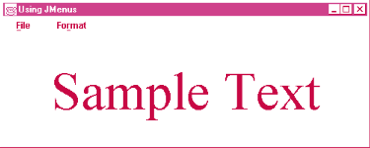
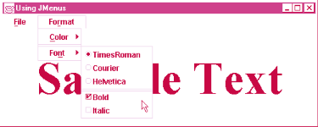
Program Output

Slide 115
